Slide 1
AIRBNB MARKET DASHBOARD
INSIGHTS FROM “AIRBNB LISTINGS DATA”
BY
L.KAVITHA
11-4-2025

Slide 2
Overview of AIRBNB
Airbnb is an American company operating an online marketplace that connects hosts and travelers, facilitating short- and long-term homestays and experiences globally, acting as a broker and charging a commission from each booking.
Overview of this project
To analyze Airbnb listings data and visualize trends, and geographic distributions to support decision-making for property owners, investors, and analysts.
Source of Data :AIRBNB Listings data of Chicago and New Orleans citites
Time Period of Analysis: 1week

Slide 3
Data Cleaning:
Done using Power BI
First Chicago listings files cleaned
Second New Orleans files cleaned
Appending two files
Filtered
Load to Power Bi visual page

Slide 4
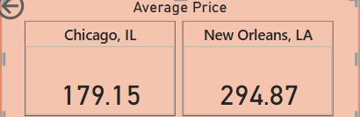
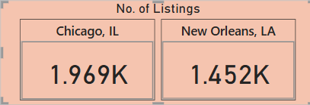
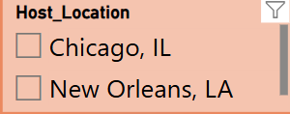
KEY METRICS
Average Price of two cities
No. of listings of two cities
List of Cities

Slide 5
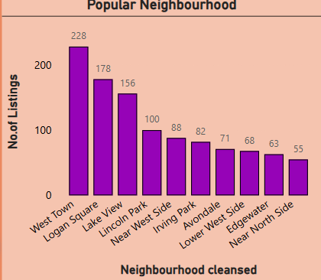
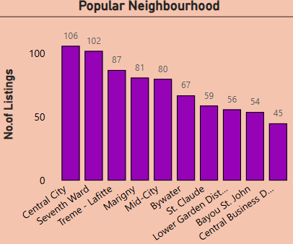
List of popular Neighbourhoods of two cities
Displays top 10 popular neighbourhood based on no. of listings of two cities.
Stacked Column Bar is used .
Top 10 Chicago Neighbourhoods Top 10 New Orleand Neighbourhoods

Slide 6
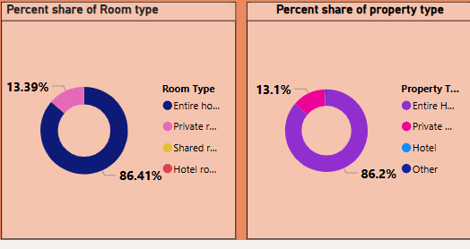
Property Analysis
Displays Percent share of both property type and room types of both cities
Pie chart is used
Used “show values as” option to find percent share
Percent share of both property types and room types are similar

Slide 7
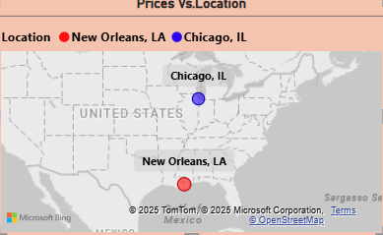
Pricing Analysis
Price Vs. Location
Map Visual is used.
Price is calculated based on location.

Slide 8
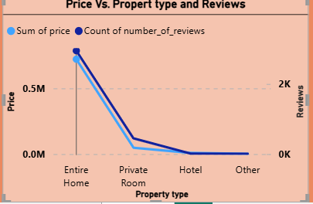
Price Vs. Property type and Reviews
1.Line chart is used.
2. No. of reviews is increased for both cities, the price is also increased for both cities based on property.

Slide 9
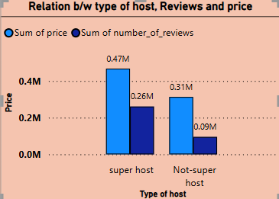
Host Analysis
Analyze and differentiate the type of host in separate column.
Clustered Column chart is used to find correlation between type of host and factors like reviews and price.
Here, reviews gets increased,price is also increased based on type of host.

Slide 10
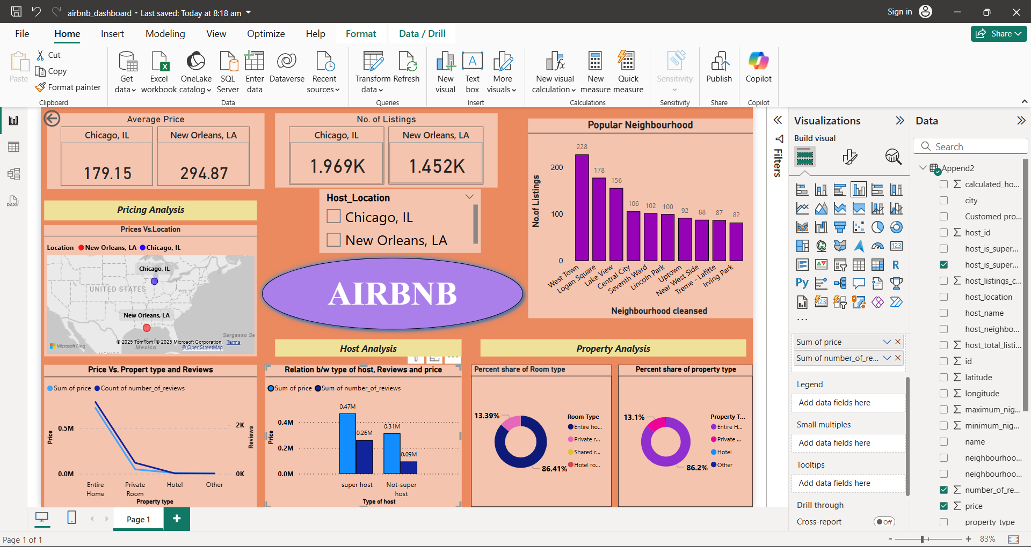
DASHBOARD OF AIRBNB

Slide 11
Conclusion
Average price varies based on location.
Average price of New Orleans is high when compared to Chicago.
Investors can focus high –performing areas with consistent demand.
Hosts can adjust prices based on seasonal trends.

Slide 12
THANK YOU

